Slide 1
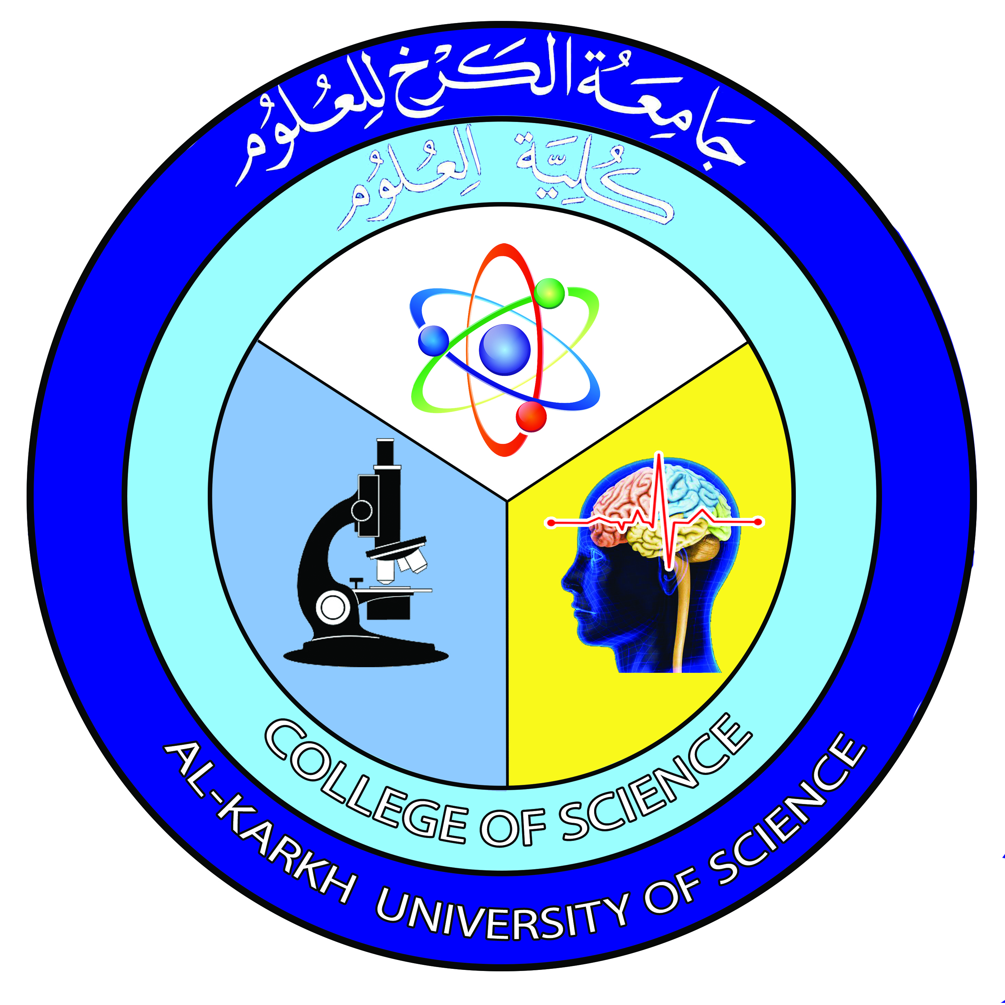

General Biology
Lecture 2
Dr. Rawa Abdul Redha Aziz
Ph.D Antibiotics/ Molecular biology

Slide 2
The characteristics of living organisms
All living things or organisms shared the following basic characteristics:
Evolution: A central organizing concept in biology is that life changes and develops through evolution, and that all life-forms known have a common origin. The theory of evolution postulates that all organisms on the Earth, both living and extinct, have descended from a common ancestor. Biologists regard the ubiquity of the genetic code as definitive evidence in favor of the theory of universal common descent for all bacteria, archaea, and eukaryotes.

Slide 3
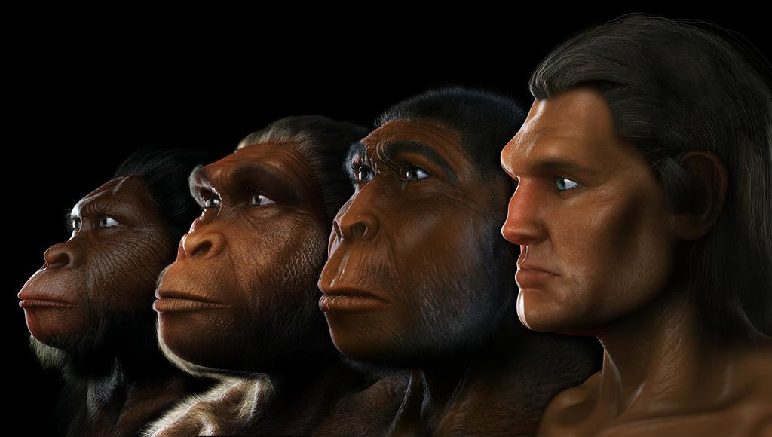

Slide 4
Adaptation: The ability to change over time in response to the environment. This ability is fundamental to the process of evolution and is determined by the organism's heredity, diet, and external factors.
Respiration: A process in living organisms involving the production of energy, typically with the intake of oxygen and the release of carbon dioxide from the oxidation of complex organic substances.
Homeostasis: Is the ability of an open system to regulate its internal environment to maintain stable conditions by means of multiple dynamic equilibrium adjustments that are controlled by interrelated regulation mechanisms. All living organisms, unicellular or multicellular, exhibit homeostasis. One example is the release of glucagon when sugar levels are too low.

Slide 5
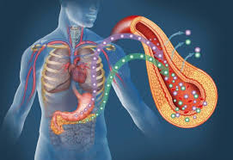

Slide 6
Organization: Being structurally composed of one or more cells – the basic units of life. Metabolism: Transformation of energy by converting chemicals and energy into cellular components (anabolism) and decomposing organic matter (catabolism). Living things require energy to maintain internal organization (homeostasis) and to produce the other phenomena associated with life.
Anabolism: The synthesis of complex molecules in living organisms from simpler ones together with the storage of energy; constructive metabolism.
Catabolism: The breakdown of complex molecules in living organisms to form simpler ones, together with the release of energy; destructive metabolism

Slide 7
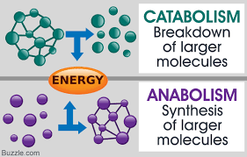

Slide 8
Growth: Maintenance of a higher rate of anabolism than catabolism. A growing organism increases in size in all of its parts, rather than simply accumulating matter.
Respond to stimuli: A response can take many forms, from the contraction of a unicellular organism to external chemicals, to complex reactions involving all the senses of multicellular organisms. A response is often expressed by motion; for example, the leaves of a plant turning toward the sun (phototropism), and chemotaxis.
Reproduction: The ability to produce new individual organisms, either asexually from a single parent organism or sexually from two parent organisms. These complex processes, called physiological functions, have underlying physical and chemical bases, as well as signaling and control mechanisms that are essential to maintaining life.

Slide 9
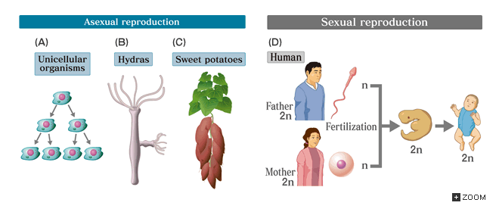

Slide 10

Any Question?

